Slide 1
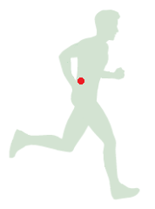
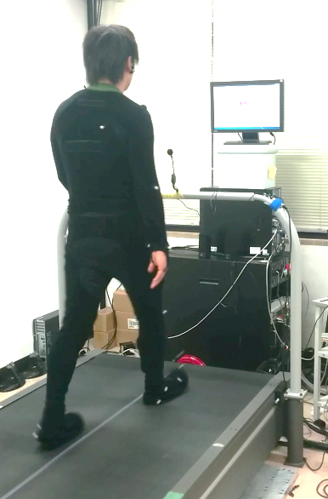
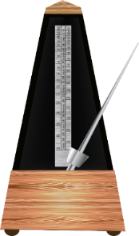
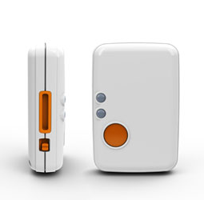

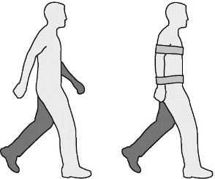
Clinical System to Identify Gait Dynamics Using IMUs
Tony Kung, Jaeeun Yoo, Masahiro Shinya, Matija Milosevic, Kei Masani
Motion Capture Data
Collect Similar Data with a Single IMU
Normal Walking
Metronome
?
Dynamic
Stability
Optimal IMU location & Gait Parameters
Compare data amongst the four conditions
Identify the optimum location for IMU to identify the gait dynamics
IMU on ankles to identify Gait Parameters
Stroop Test
Restricted Arm
- Robertson DG et al. Research Methods in Biomechanics. 2014.
- Shimmer, Shimmer3 IMU Unit. 2017.
1

